Slide 1
An explorative approach to
unsupervised intent recognition
Steeve Laquitaine

Slide 2
Main application: Conversational AI, will alone be worth $14 Billion in 2025,
reflecting the ever-increasing demand for AI-powered customer support and engagement.
Sophisticated models that compete in performance and in complexity on benchmark corpora of annotated queries.
Models are typically classification or sequence models trained on databases of annotated queries then used to predict intents on unseen utterances.
Despite the approach’s growing popularity, it relies on extensive human annotations and its opacity provides little to no insights into the structure of intent representation.
The unsupervised approach, far less explored, could be used to reduce labelling workload while enabling the elaboration of a clear and concise formal model of natural language intent.

Slide 3
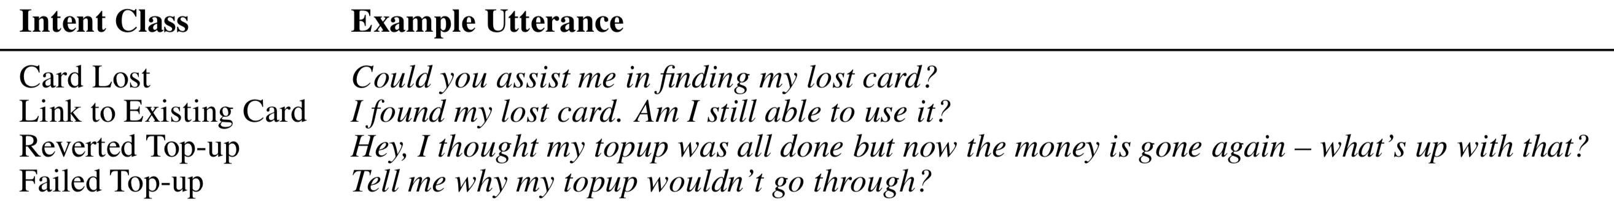
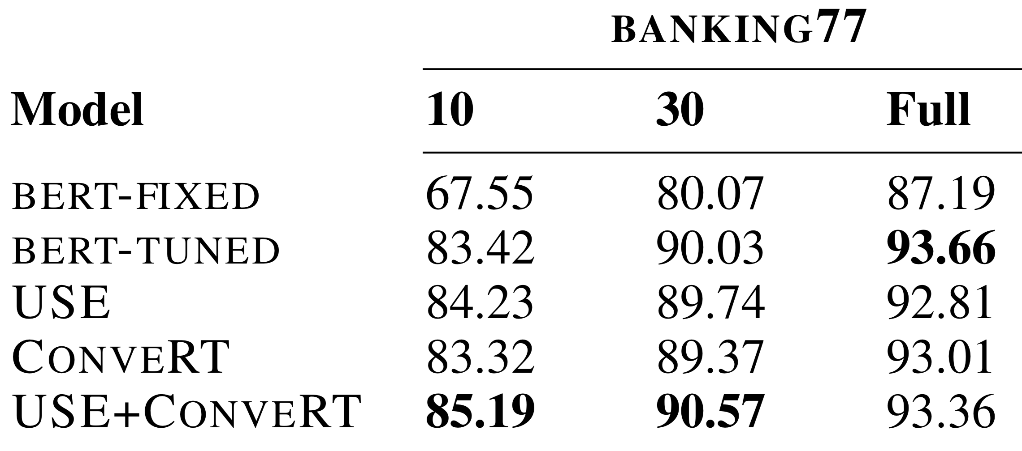
“Banking77” vocabulary is very discriminant requires few labels … but still requires labels
Instances per labels
^{Casanueva et al., arxiv} ^{２０２０}

Slide 4
“Banking77” vocabulary is very discriminant requires few labels … but still requires labels
Instances per labels
^{Casanueva et al., arxiv} ^{２０２０}

Slide 5
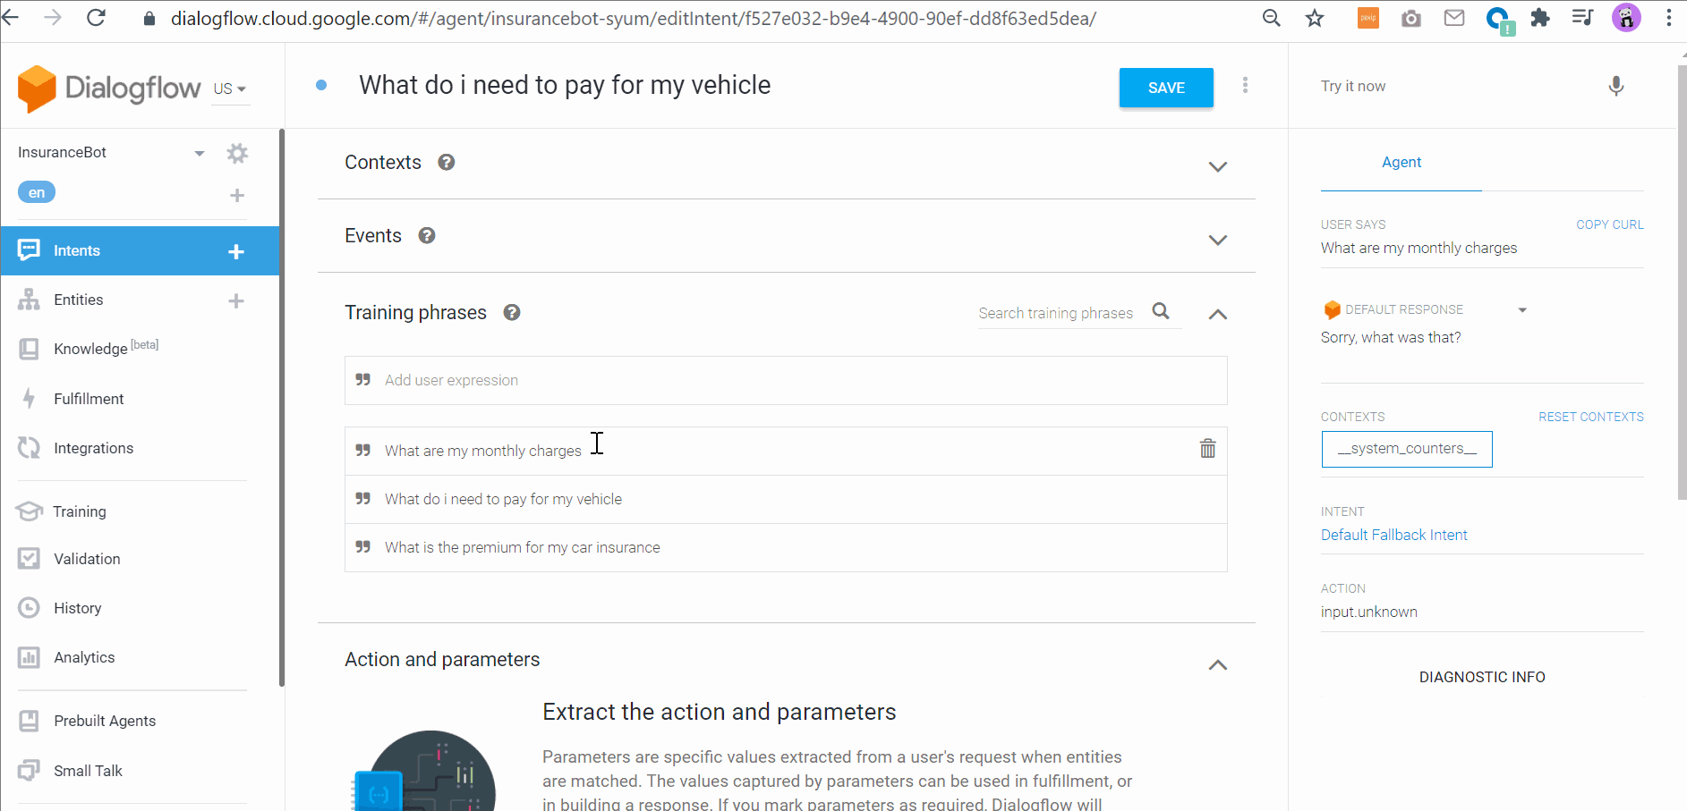
Similar DNN are likely powering Google, Microsoft & other NLU engines

Slide 6
There is no dominant formal model of intent in NLU yet
Hollerit et al, 2013
“An intent …contains at least one verb and
describes the user’s intention to commit an
activity in a recognizable way”
notions of “explicit” and “implicit”
ATIS corpus
“Nominal intent” (#flight_info,)
“What flights are available from Pittsburgh to Baltimore on thursday morning” ->
IBM Watson
#Covid_Am_I_Infected
#weather_conditions
#pay_bill
#excalate_to_agent
Mycroft AI adapt
"Play Mozart in Spotify”
IntentType: #MusicType
MusicVerb: "play”
Artist: "Mozart”
MusicKeyWord: "spotify"
Wang et al., 2015
“intent-indicator”: … express intents: verb or infinitive phrase that … follows a subject
“I want to buy an xbox”-> (“want to”,)
“Intent-Keyword”: noun, verb, multi-word verb or compound noun contained in a verb or noun phrase which … follows an intent-indicator,
“buy an xbox” → (“buy”, “xbox”)
Vedula et al., 2019
Explicit intents are actionable
Made of two functional parts:
an “action” and an “object”

Slide 7
Intent has no dominant formalization yet
Notion of taxonomy
Broder et al., 2002 “classes”
navigational
transactional
informational
hierarchy of intents (4, p.9)
speech acts: requests, commands, ...
Calder ́on-Benavides et al., 2010, “Facets”
genre
objective
specificity
scope
topic
task
authority sensitivity
spatial sensitivity
time sensitivity
Cai et al.,
Used hierarchical taxonomy of intent

Slide 8
Intent Corpora
CLINC
Industries: Banking, Computer, Air Travel, Movie industry, Food service industry
* Sector:
* cross-domains: 10
* Banking, Work, Meta, auto & commute, travel, home, utility, kitchen & dining, small talk, credit cards
* task: task-oriented dialog, commands
* sample size: 23,700 instances
* intents: 150 intents
* multiple or single intent: single
* 22,500 in-scope queries + 1,200 out-of-scope queries
* mean sentence length: short (~10 words)
* train input:
* format: .JSON
* size: 2.38 MB
* Generation:
* crowdsourcing from Quora, Wikipedia, etc.,...
* pros
* Ecological relevance:
* business relevant: many classes that emulate commercial systems env.
* many intents [13]
* Contains in-scope & out-of-scope queries
* out-of-scope means not associated w/ any intents in the dataset

Slide 9
Intent Corpora
HWU64 (Liu 2019`)
* task: task-oriented dialog, commands
* 25,716 instances
* 64 intents
* 54 Entity types
* license: CC BY-SA 3.0
* corpus url: [26]
* paper: [27]
* generation:
* annotated by 3 students, mechanical turk
* cross-domains:
* 21
* alarm, audio, audiobook, calendar, cooking, datetime, email, game, general, IoT, lists, music, news, podcasts, general Q&A, radio, recommendations, social, food takeaway, transport, and weather
* unbalanced
* train input
* format: .csv
* size: 5.6 MB
* pros
* Ecological relevance:
* many intents, emulates commercial systems env. [13]

Slide 10
Intent Corpora
Banking77
* Sector: Finance
* Industry: Banking
* task: task-oriented dialog
* 13,083 {question, intents}
* 77 intents
* train input format: .csv
* url: [13]
* corpus url [30]
* license
* pros
* Ecological relevance:
* many intents, emulates commercial systems env. [13]

Slide 11
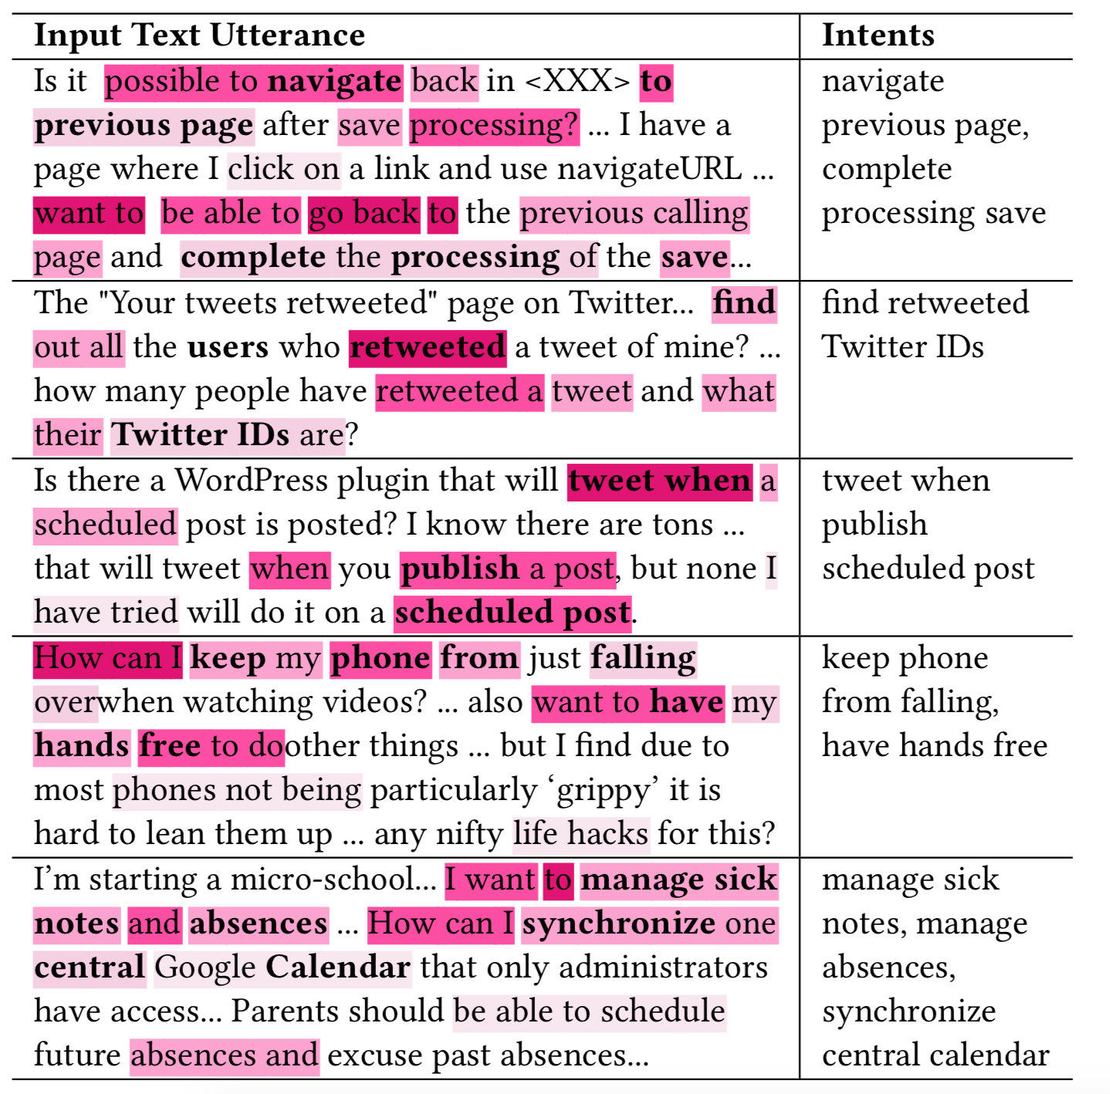
VB
stuff
tweet when ..
Vedula al, 2019, arxiv

Slide 12
Seed + noise
VB
stuff
tweet when ..
Vedula al, 2019, arxiv

Slide 13
Formalizing intent
Seed + noise
VB
NP
navigate to previous
VB
NP
find out all the users …
VB
PP
tweet when ..
VB
NP
keep my phone from …
VB
NP
manage sick notes
Vedula al, 2019, arxiv

Slide 14
Do we see the same in other corpora ?
Card arrival
How do I track the card you sent me?
Can I track the card you sent to me?
How can I periodically check the delivery of the card you sent?
Could I get tracking on the card?
Can I track the card that you just sent to me?
Can I track the card that you sent me in the mail?
When will I receive my new card?
Do you have info about the card on delivery?
Can you share card tracking number?
Context-free grammar
VB
NP
Track the card you sent …
Intent → VP
VP → Verb ?X ?Y
Verb → VB | VBD ..
Banking77

Slide 15
Do we see the same in other corpora ?
It seems so ..
Card arrival
How do I track the card you sent me?
Can I track the card you sent to me?
How can I periodically check the delivery of the card you sent?
Could I get tracking on the card?
Can I track the card that you just sent to me?
Can I track the card that you sent me in the mail?
When will I receive my new card?
Do you have info about the card on delivery?
Can you share card tracking number?
Context-free grammar
VB
NP
Track the card you sent …
Intent → VP
VP → Verb ?X ?Y
Verb → VB | VBD ..
Banking77

Slide 16
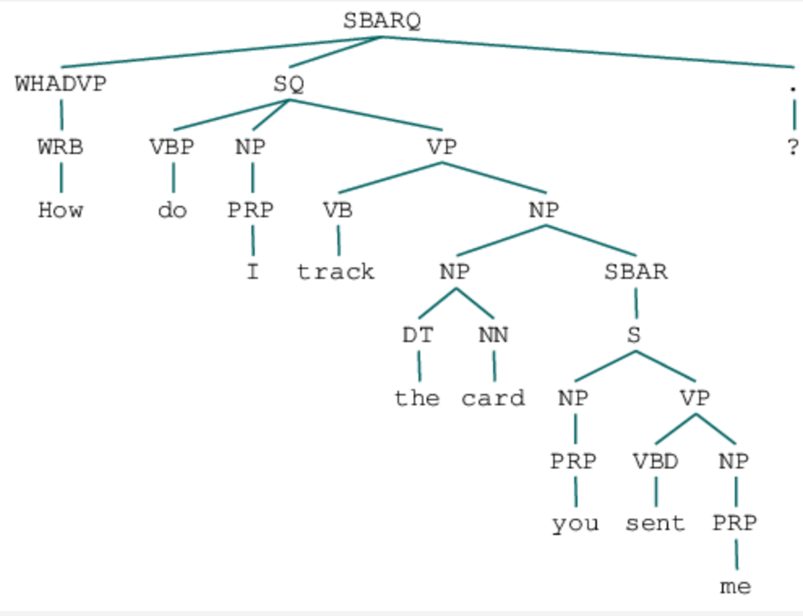
Do we see the same in other corpora ?
Card arrival
How do I track the card you sent me?
Can I track the card you sent to me?
How can I periodically check the delivery of the card you sent?
Could I get tracking on the card?
Can I track the card that you just sent to me?
Can I track the card that you sent me in the mail?
When will I receive my new card?
Do you have info about the card on delivery?
Can you share card tracking number?
Verb phrase chunking
Banking77

Slide 17
Do we see the same in other corpora ?
Card arrival
How do I track the card you sent me?
Can I track the card you sent to me?
How can I periodically check the delivery of the card you sent?
Could I get tracking on the card?
Can I track the card that you just sent to me?
Can I track the card that you sent me in the mail?
When will I receive my new card?
Do you have info about the card on delivery?
Can you share card tracking number?
Verb phrase chunking
Constituency parser + tgrep
Banking77
Intent → Track the card you sent me

Slide 18
Can we reconstruct meaningful intent clusters from the corpus ?
Verb phrase chunking
Semantic similarity analysis
0.1
0.7 | 0.09
“track the card
you sent me”
“exchange
currency
with this app”
“receive the new card sent”
Constituency parser + tgrep
“track the card
you sent me”
“exchange
currency
with this app”
“receive the new card sent”
Intent → Track the card you sent me

Slide 19
Can we reconstruct meaningful intent clusters from the corpus ?
Verb phrase chunking
Semantic similarity analysis
“track the card
you sent me”
Wordnet-based
shortest path distance
similarity
“exchange
currency
with this app”
“receive the new card sent”
Constituency parser + tgrep
“track the card
you sent me”
“exchange
currency
with this app”
“receive the new card sent”
Intent → Track the card you sent me

Slide 20
Can we reconstruct meaningful intent clusters from the corpus ?
Verb phrase chunking
Semantic similarity analysis
Word sense
disambiguation
“track the card
you sent me”
“exchange
currency
with this app”
Wordnet-based
shortest path distance
similarity
“receive the new card sent”
Constituency parser + tgrep
“track the card
you sent me”
“exchange
currency
with this app”
“receive the new card sent”
Intent → Track the card you sent me

Slide 21
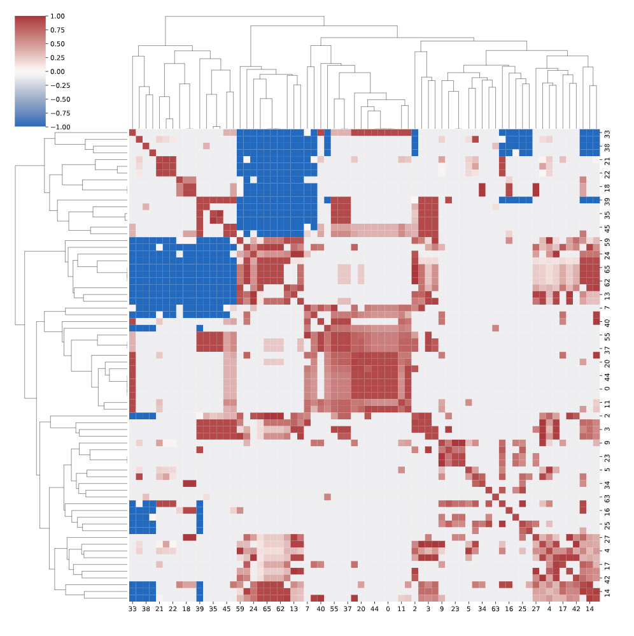
Can we reconstruct meaningful intent clusters from the corpus ?
Verb phrase chunking
Constituency parser + tgrep
Intent → Track the card you sent me
Semantic hierarchical clustering (dist. thres = 5 for two classes)

Slide 22
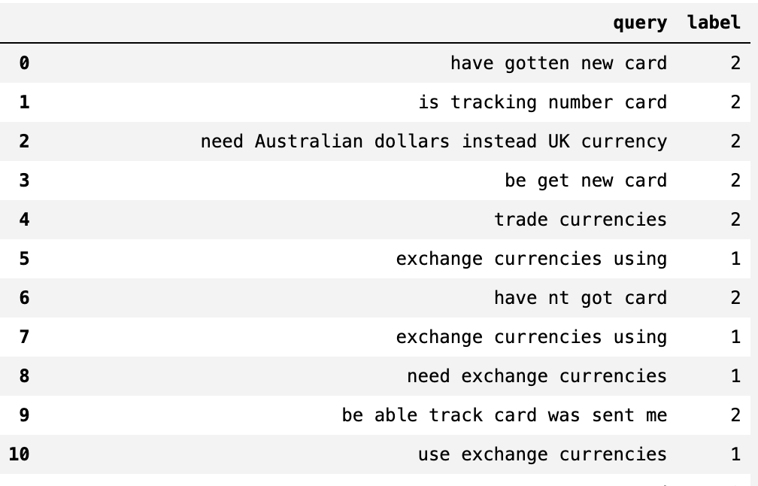
Can we reconstruct meaningful intent clusters from the corpus ?
Some good labels but need real eval.
Semantic hierarchical clustering (dist. thres = 5 for two classes)

Slide 23
Can we reconstruct meaningful intent clusters from the corpus ?
On a good path
Some good labels but need real eval.
Semantic hierarchical clustering (dist. thres = 5 for two classes)

Slide 24
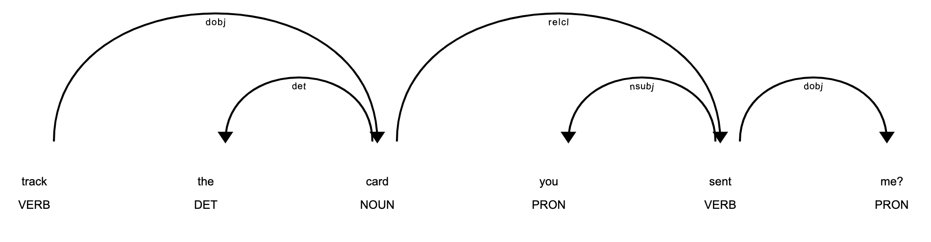
Exploring increased intent expressiveness
How do I track the card you sent me?
Verb phrase chunking
Functional parsing
intent, intendeed
Parametrization
intent, intendeed, entities
{
Intent: track
Intendeed: card
entities: [
{date: None,
?x: None
pp: you sent me
},
]
}
dobj
relcl
dobj
det
nsubj
root
Track the card you sent me
Constituency parser + tgrep
Dependency parser
Named entity recognition

Slide 25
Exploring increased intent expressiveness
How do I track the card you sent me?
Verb phrase chunking
denoising
Functional parsing
intent, intendeed
Parametrization
intent, intendeed, entities
{
Intent: track
Intendeed: card
entities: [
{date: None,
?x: None
pp: you sent me
},
]
}
dobj
relcl
dobj
det
nsubj
root
Track the card you sent me
Constituency parser + tgrep
Dependency parser
Named entity recognition

Slide 26
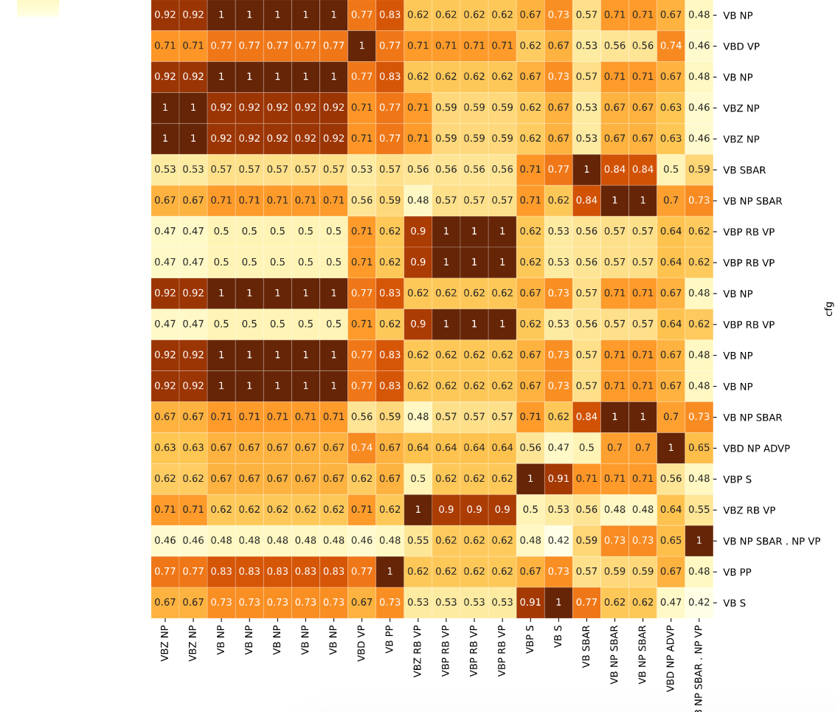
Denoising intents based on similarity to a seed syntax
How do I track the card you sent me?
Verb phrase chunking
Constituency parser + tgrep
Longest common path similarity to VP → VB NP

Slide 27
Factored approach
Structured approach
How do I track the card you sent me?
How do I track the card you sent me?
Filtering
by query complexity
by sentence mood
Constituency parsing
Constituency parsing
Filtering
Exists in wordnet
Filtering
by syntactical complexity
Word sense disambig.
Dependency parsing
Filtering
First dobject
Semantic h.clustering
Named entity recog.
{
Intent: track
Intendeed: card
entities: [
{date: None,
?x: None
},
]
}
Factored intent
Class label
Expressive structured
intent

Slide 28
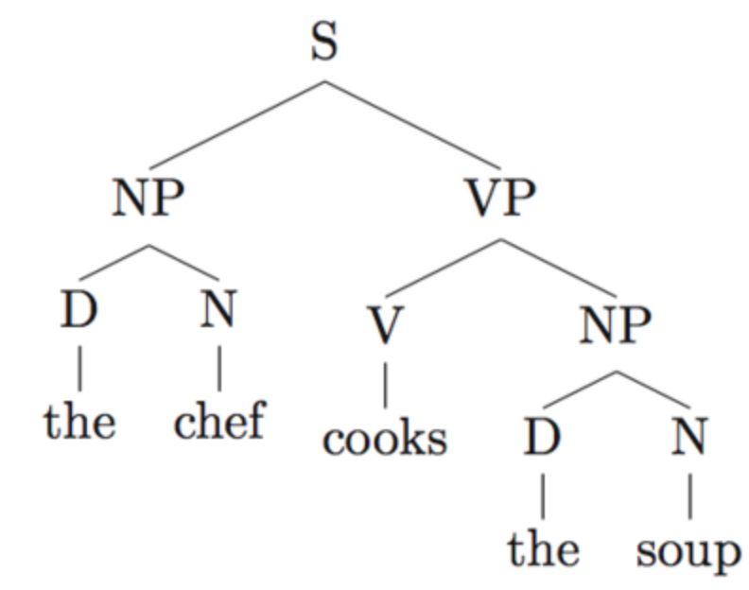
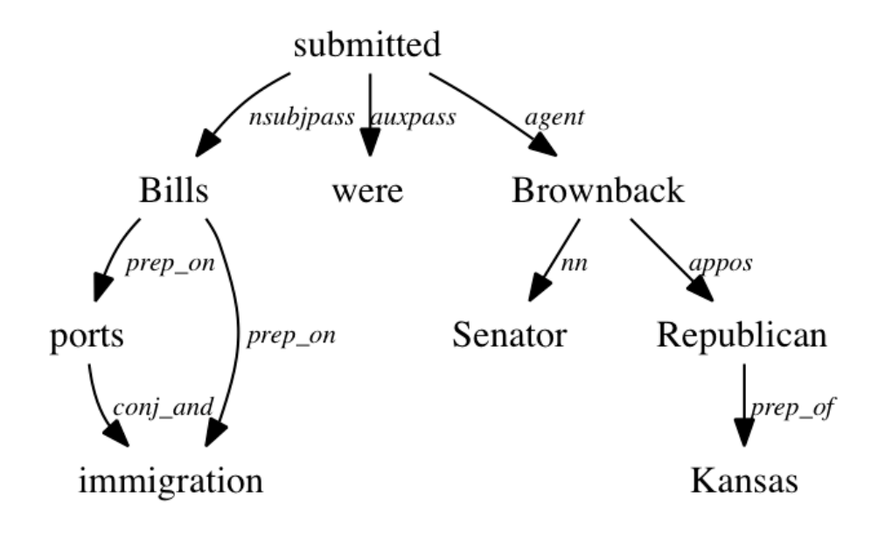
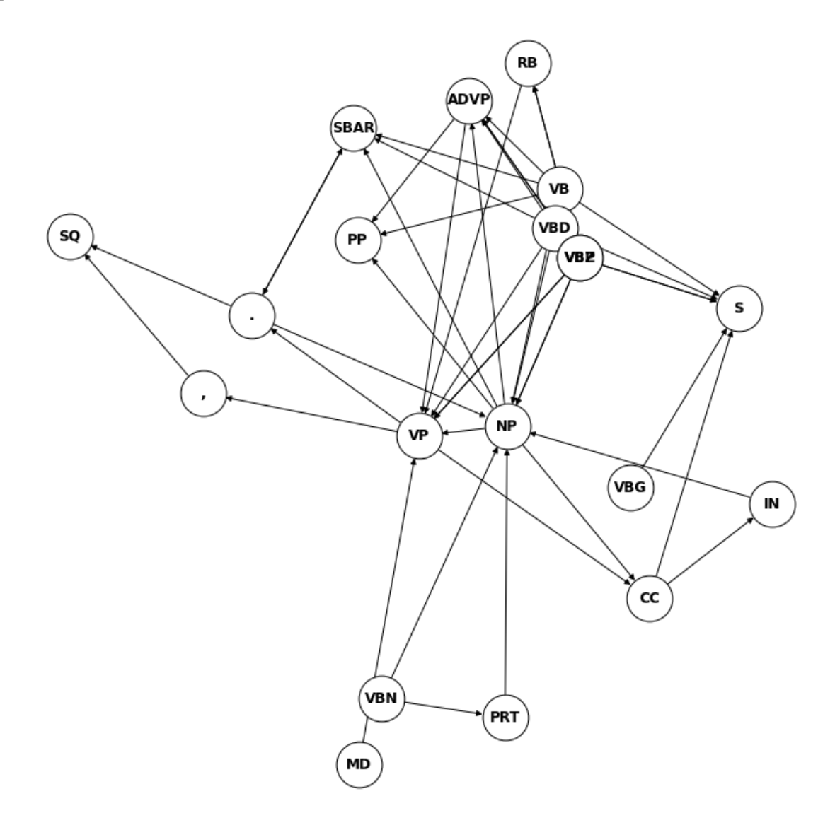
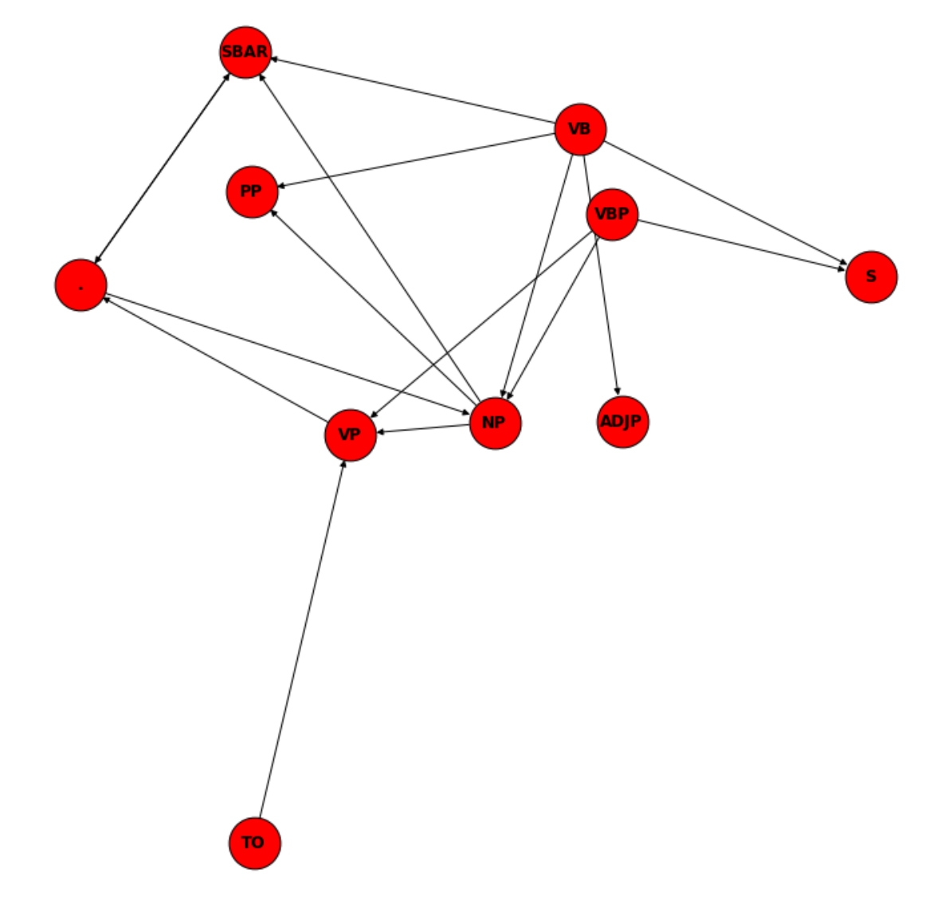
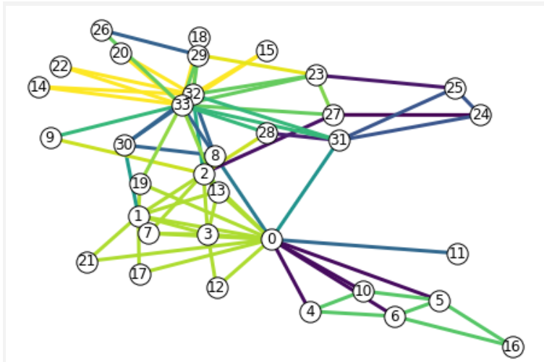
Perspectives
Improve data understanding
Understand how structural ambiguity affects parsing
Improve similarity analysis
Improve semantic disambiguation with Levin’s classes and verbnet
Bridge and simplify the factored and structured approaches
etc …
Constituency parsing
Verb phrase
Extraction
(tree search)
“I want to order
a credit card.”
Dependency parsing
Word graph
conversion
Similarity
ranking

Slide 31
Can we reconstruct meaningful intent clusters from the corpus ?
On a good path
Some good labels but need real eval.
Semantic hierarchical clustering (dist. thres = 5 for two classes)

Slide 32
Can we reconstruct meaningful intent clusters from the corpus ?
On a good path
Some good labels but need real eval.
True labels
Semantic hierarchical clustering (dist. thres = 5 for two classes)

